Slide 1
Rapid City Downtown Focus Group
July 15, 2025

Slide 2
Meeting Objectives
Rapid City SS4A plan overview
Discuss key roadway safety issues in Rapid City, particularly in downtown

Slide 3

Introductions
Name
Your travel experience in Rapid City
  Car
  Foot
  Bike
  Etc.
Notes:
Goal: Meet the folks in the room and get a feel for how safe/comfortable they feel driving in general. Note any mentions of particular corridors/opportunities, etc.

Slide 4
Project Background

Slide 5
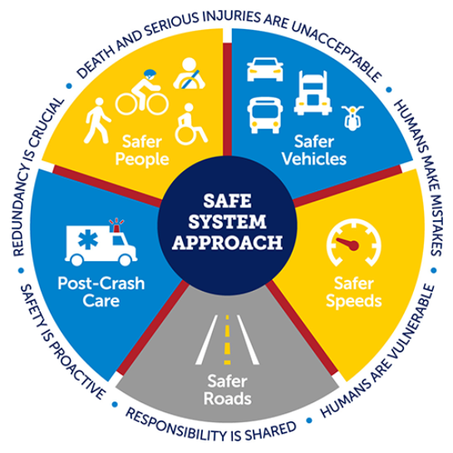
Safe System Approach
Eliminate traffic deaths and serious injuries.
Improve overall safety of the transportation network for all users.
Implement the Safe System Approach (SSA).
Notes:
The Safe Streets and Roads for All (SS4A) program is dedicated to implementing strategies that eliminate traffic deaths and serious injuries and improve the overall safety of the transportation network for all users.
Reaching zero deaths requires the implementation of a Safe System Approach (SSA). The SSA is comprised of five core elements and six principles.

Slide 6
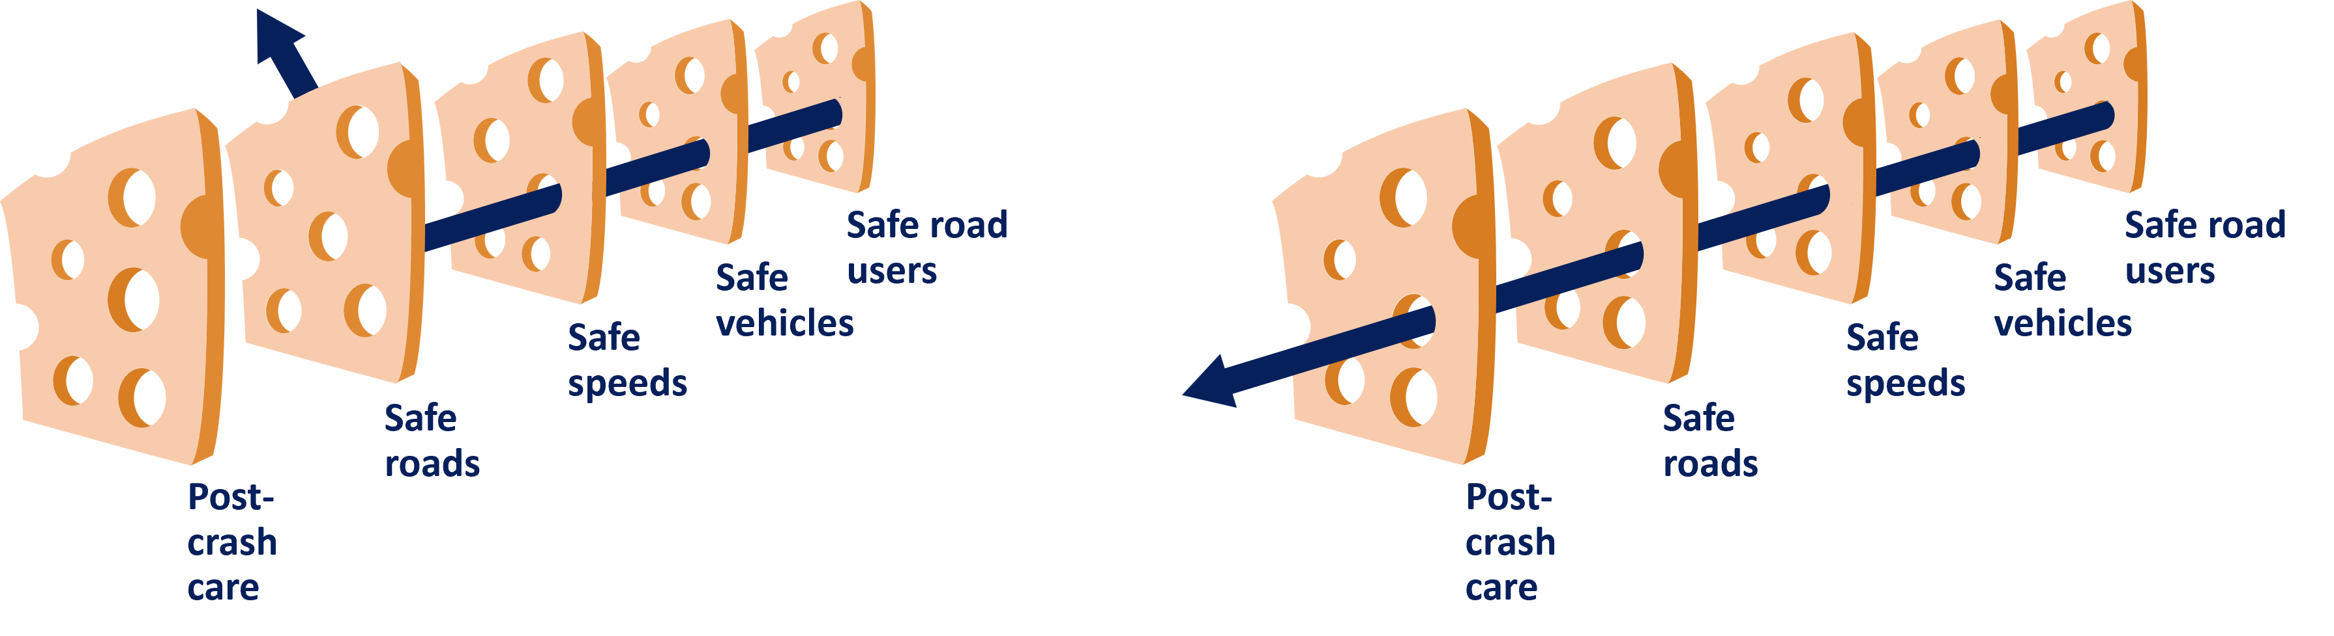
Safe System Approach
Focuses on both human mistakes and human vulnerability.
Designing systems with layers of protection.
Notes:
The Safe System Approach is a shift from conventional road safety thinking because it focuses on both human mistakes and human vulnerability by designing systems with layers of protection.
If one countermeasure fails, another will help prevent a crash or lessen the likelihood of serious injury or death.

Slide 7
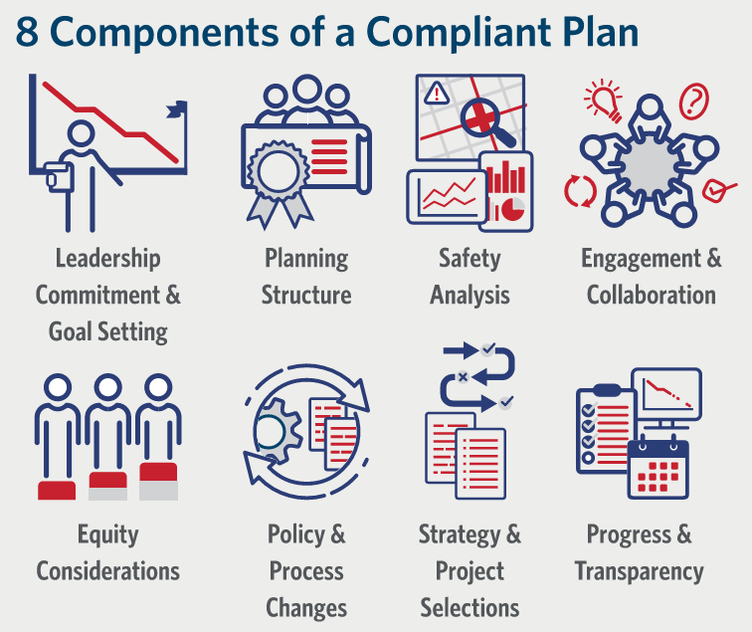
Components of a Project Plan
A holistic, well-defined strategy.
Prevent roadway fatalities and serious injuries.
Notes:
According to the USDOT, the goal of an Action Plan is to develop a holistic, well-defined strategy to prevent roadway fatalities and serious injuries.
A successful Action Plan includes the following eight key components.

Slide 8
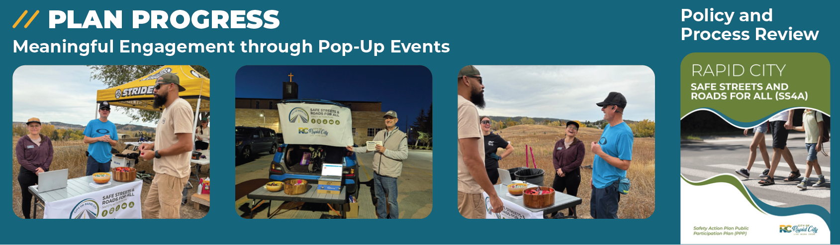
Study Progress

Slide 9
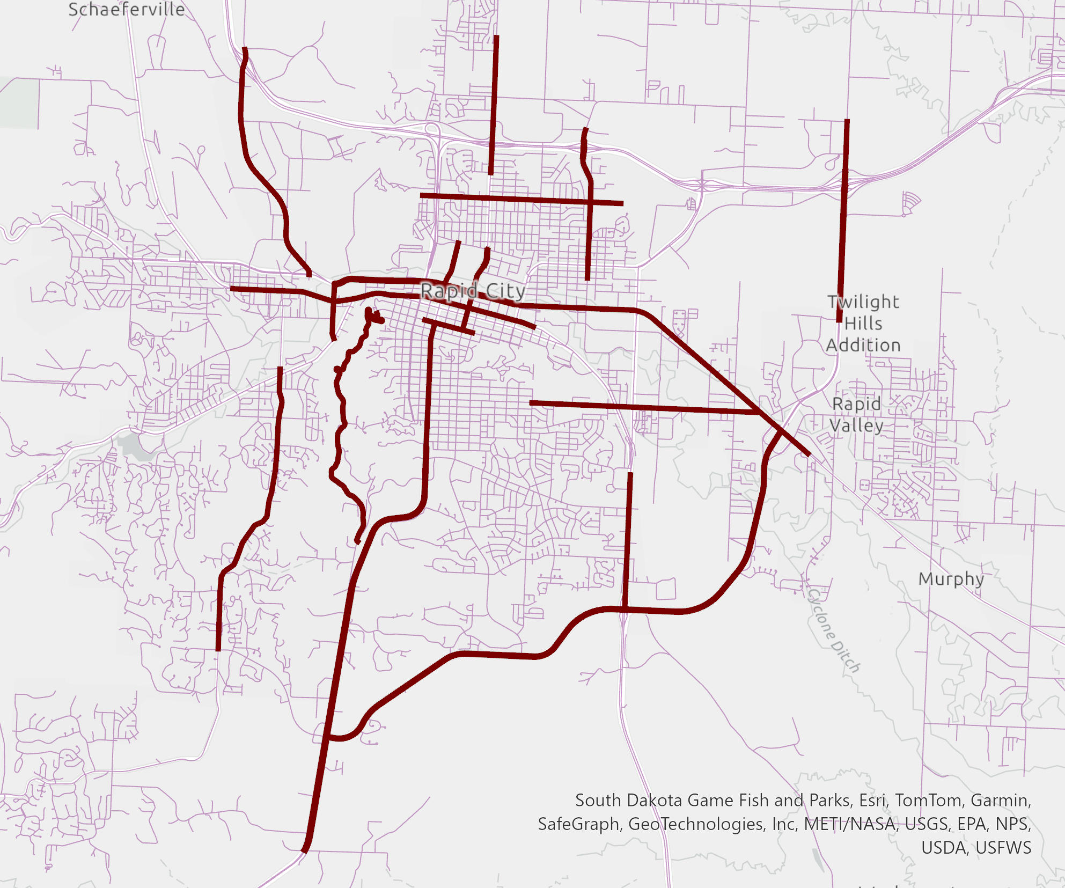
Study Purpose
70% of fatal or serious injury crashes (KA crashes) occur on 11% of Rapid City’s road network
The safety action plan will target this smaller area to focus on eliminating fatalities and serious injuries

Slide 10
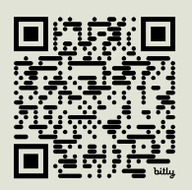
Discussion

Slide 11
General Feeling of Safety
How safe do you feel traveling in Rapid City?
1
2
3
4
5
1 – Very Unsafe
5 – Very Safe
Why?
Notes:
1 – always feel unsafe
2 – mostly feel unsafe
3 – sometimes feel safe, sometimes feel unsafe
4 – mostly feel safe
5 – always feel safe
Note that this can be by car, bike, foot, etc.

Slide 12
Areas of Concern
Do you agree with these highlighted areas?
Are there areas missing?

Slide 13
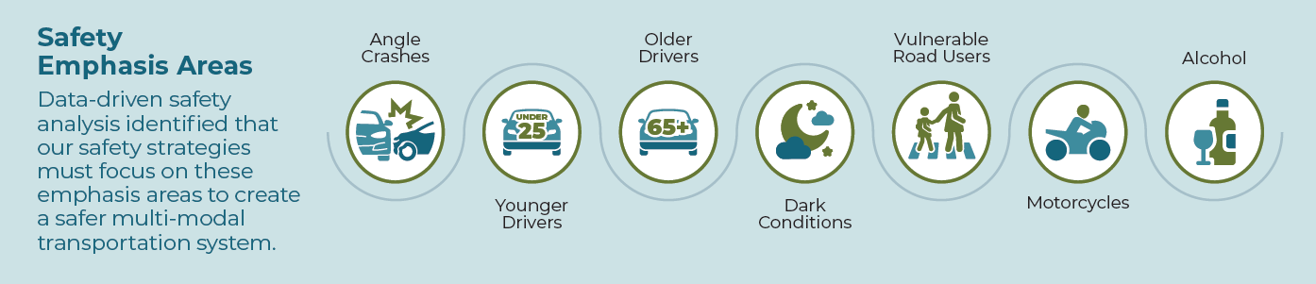
Prevalent Issues
Do you think these issues are present in Rapid City?
What issues not listed should be addressed?

Slide 14
Downtown

Slide 15
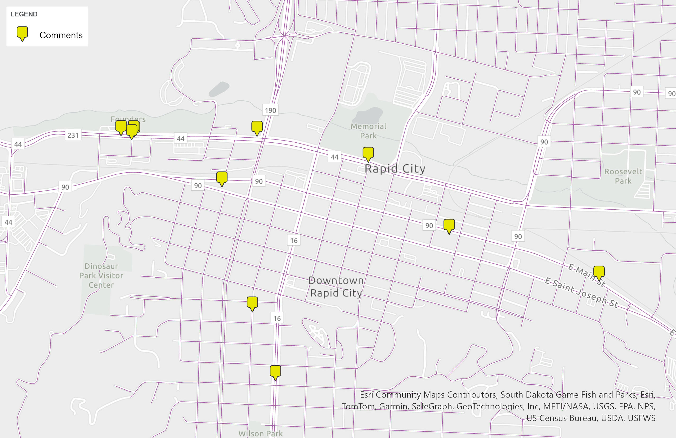
Intro Downtown Area
Safety for all users:
  Tourism
  Business
  Pedestrians and Cyclists
  Etc.

Slide 16
Comment Map Recap
Comment Themes:
Note in particular pedestrian/bicyclist safety observations
  Cars not paying attention to walkers/bicyclists
All bicycle comments

Slide 17
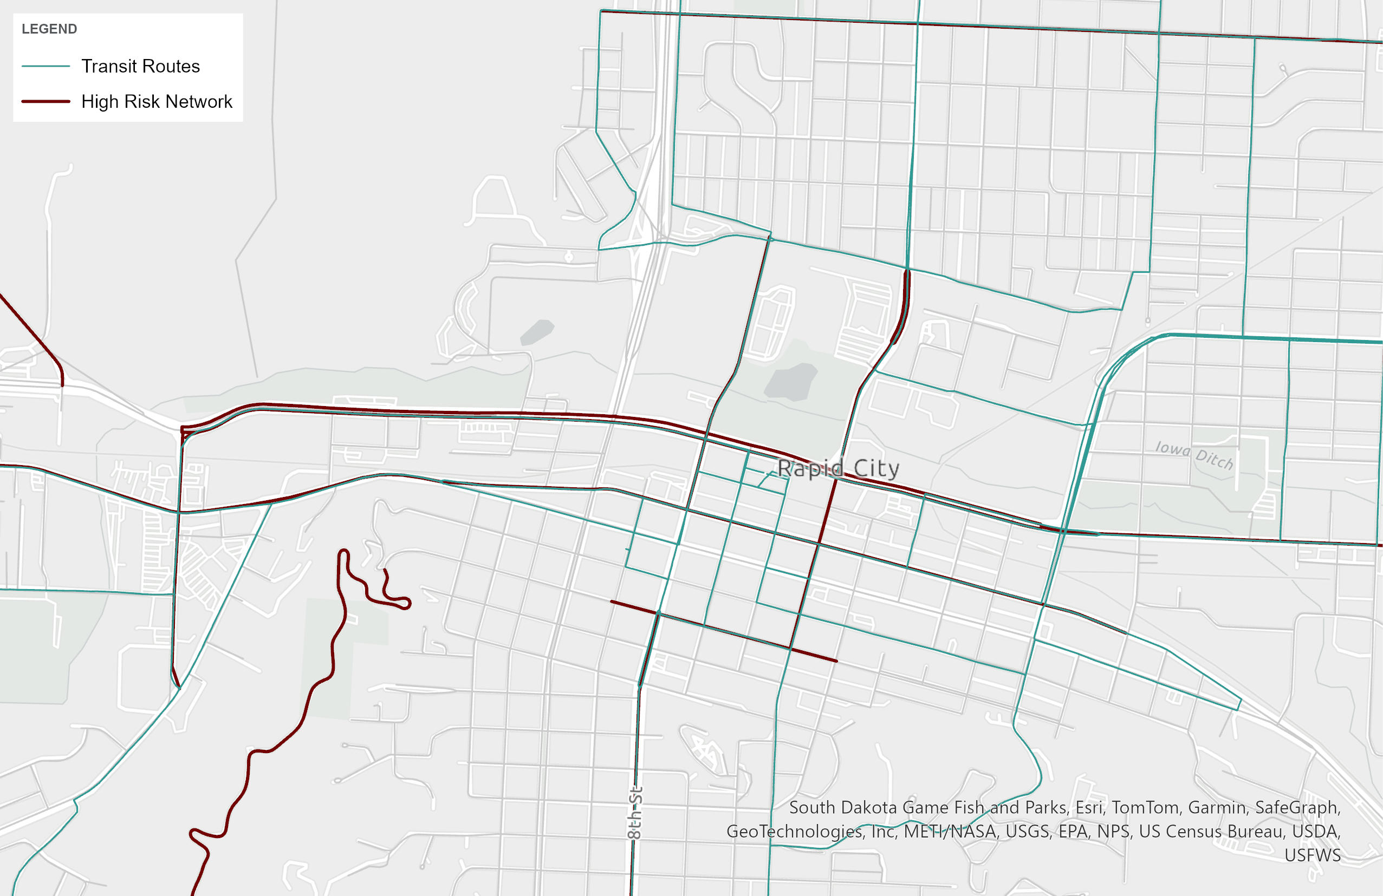
Transit
Do you use the Rapid City transit system?
Which stops are you seeing the most utilized?

Slide 18
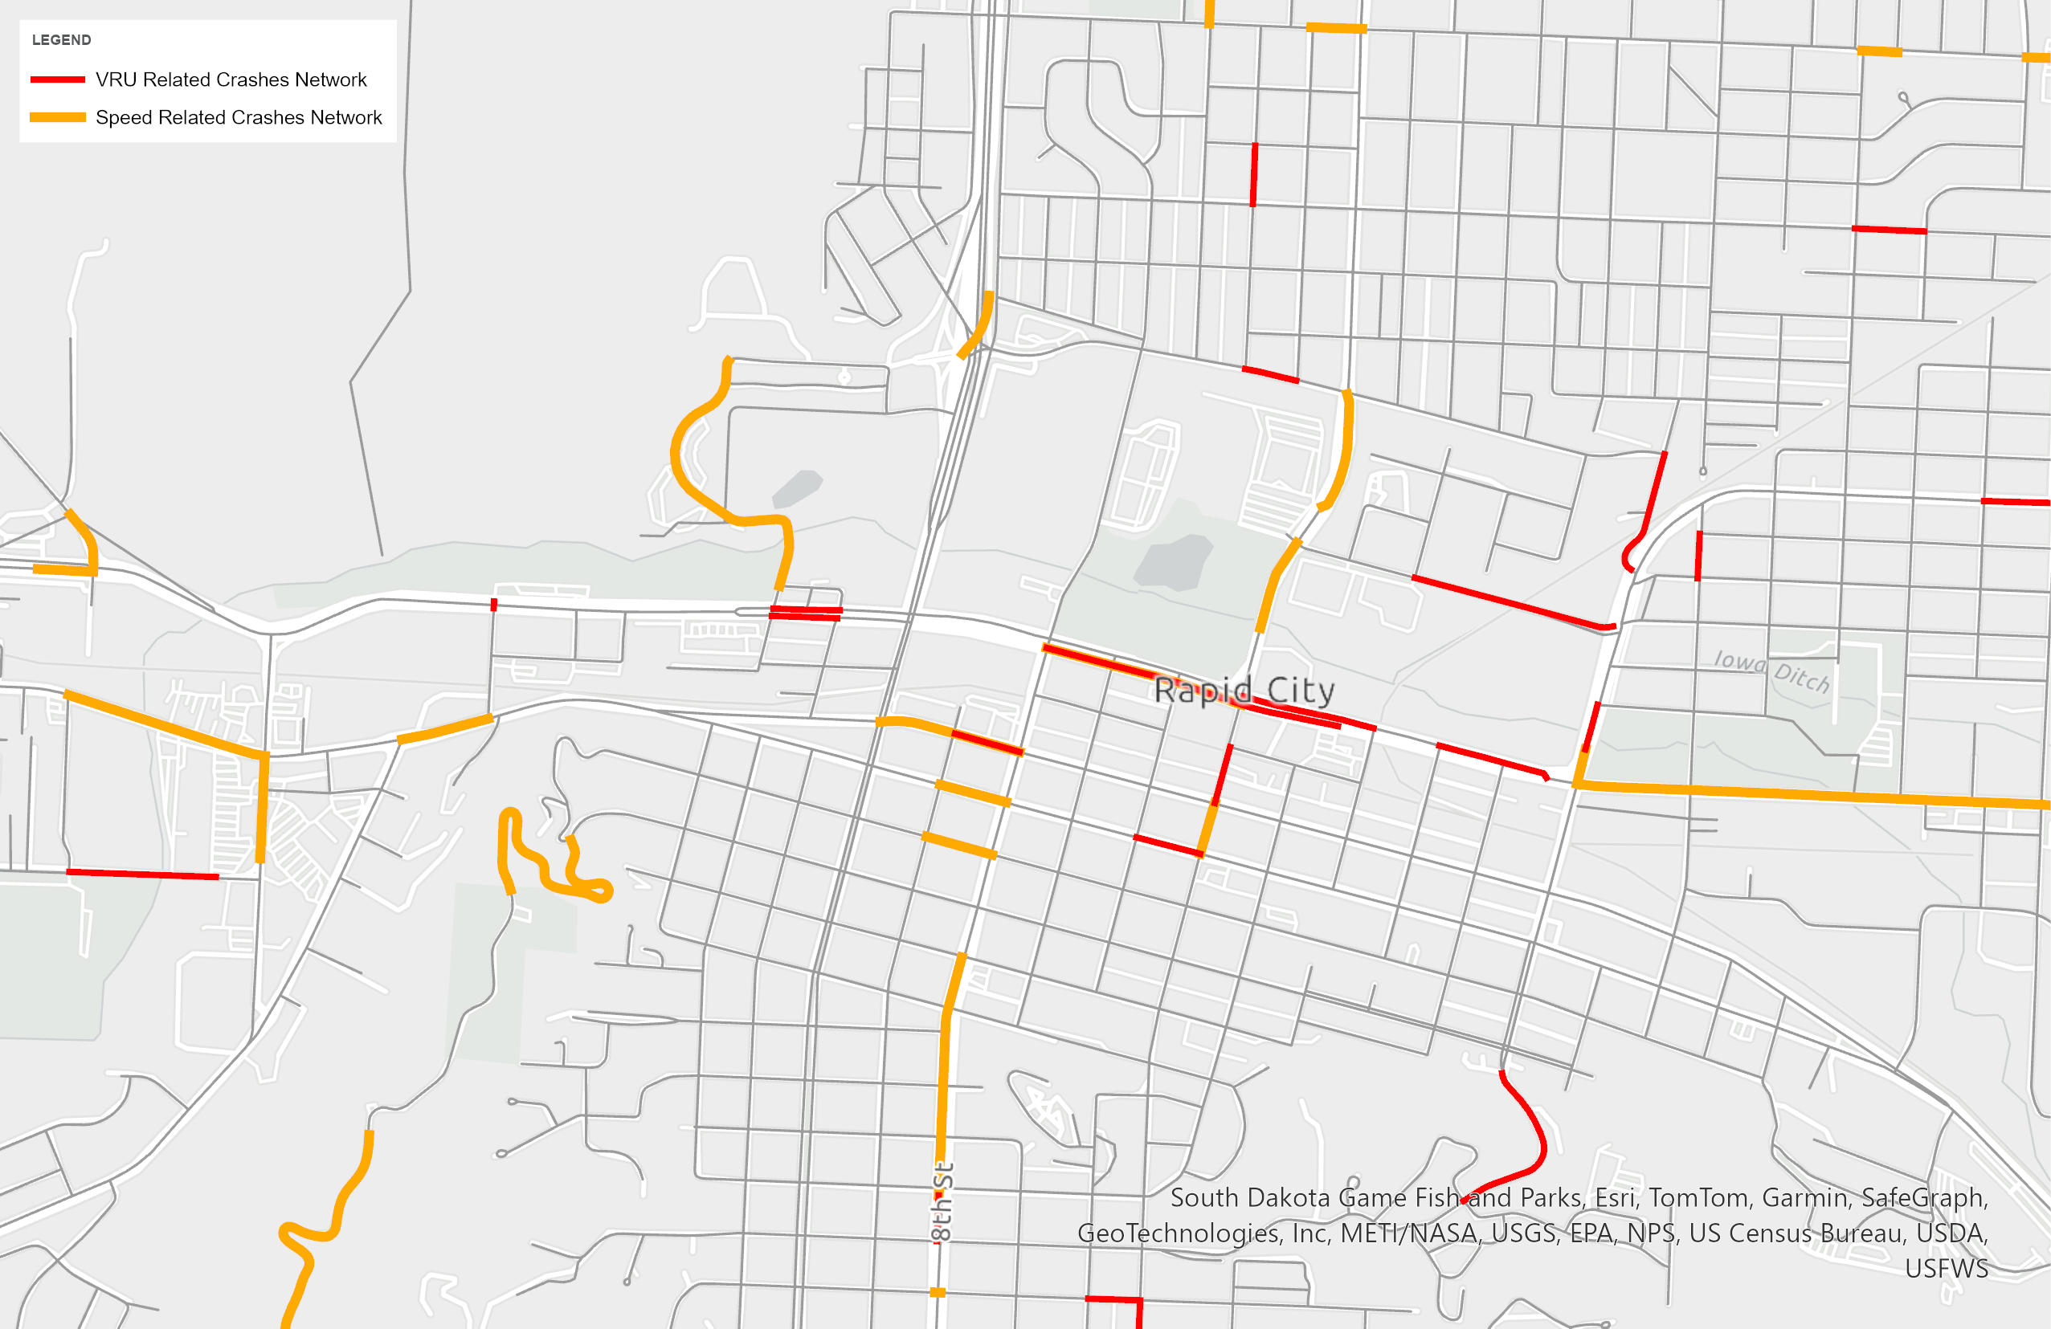
Pedestrian/Bike Safety
Does downtown feel safe for pedestrians/bikers
Do you agree/disagree with the highlighted areas of concern for pedestrians/bikers? Are there others?

Slide 19
Open Discussion
Any questions?
Any important points not hit?

Slide 20
Projects and Strategies

Slide 21
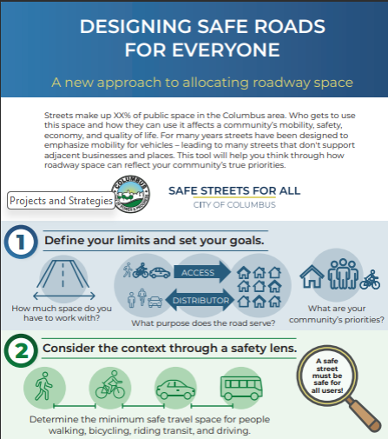
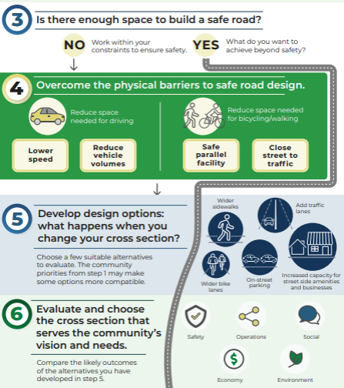
Street Rightsizing Tool

Slide 22
Map Markup
Map 1:
Mark “slower streets”
  Better for walking/biking
  Adjacent homes
  Adjacent businesses with active movement
Map 2:
Mark transit stops you use
Note safety concerns with sticky notes

Slide 23
Thank You

