Slide 1
Rapid City HPN Corridors Focus Group
July 17, 2025

Slide 2
Meeting Objectives
Rapid City SS4A plan overview
Discuss key safety issues in Rapid City
Discuss issues pertaining to the High Priority Network

Slide 3

Introductions
Name
Your travel experience in Rapid City
  Car
  Foot
  Bike
  Etc.
Notes:
Goal: Meet the folks in the room and get a feel for how safe/comfortable they feel driving in general. Note any mentions of particular corridors/opportunities, etc.

Slide 4
Project Background

Slide 5
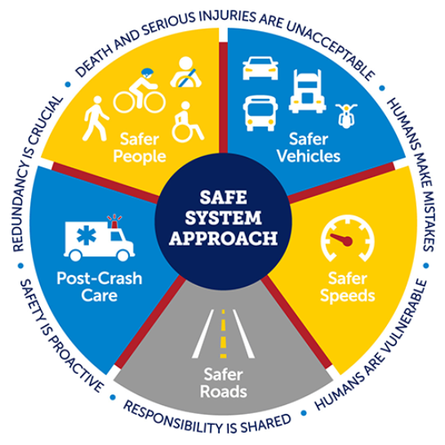
Safe System Approach
Eliminate traffic deaths and serious injuries.
Improve overall safety of the transportation network for all users.
Implement the Safe System Approach (SSA).
Notes:
The Safe Streets and Roads for All (SS4A) program is dedicated to implementing strategies that eliminate traffic deaths and serious injuries and improve the overall safety of the transportation network for all users.
Reaching zero deaths requires the implementation of a Safe System Approach (SSA). The SSA is comprised of five core elements and six principles.

Slide 6
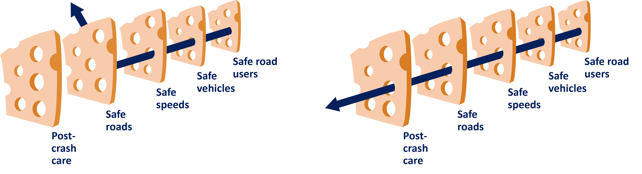
Safe System Approach
Focuses on both human mistakes and human vulnerability.
Designing systems with layers of protection.
Notes:
The Safe System Approach is a shift from conventional road safety thinking because it focuses on both human mistakes and human vulnerability by designing systems with layers of protection.
If one countermeasure fails, another will help prevent a crash or lessen the likelihood of serious injury or death.

Slide 7
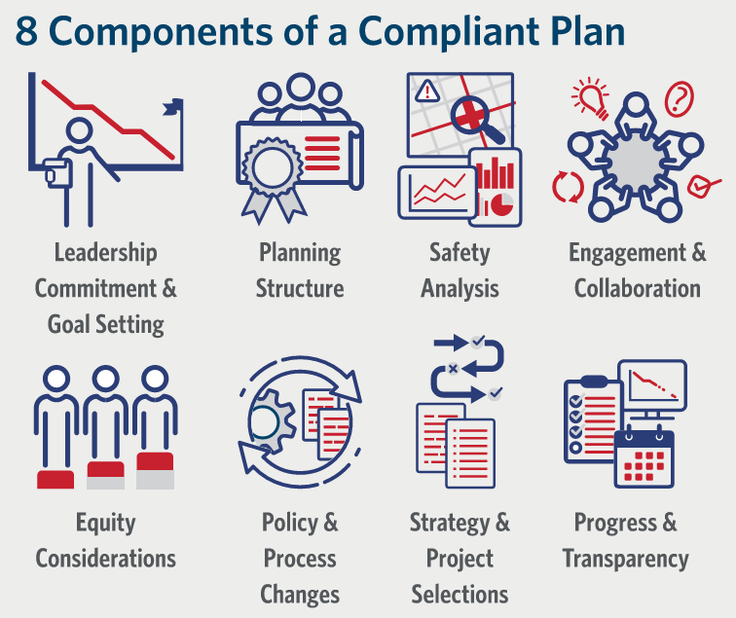
Components of a Project Plan
A holistic, well-defined strategy.
Prevent roadway fatalities and serious injuries.
Notes:
According to the USDOT, the goal of an Action Plan is to develop a holistic, well-defined strategy to prevent roadway fatalities and serious injuries.
A successful Action Plan includes the following eight key components.

Slide 8
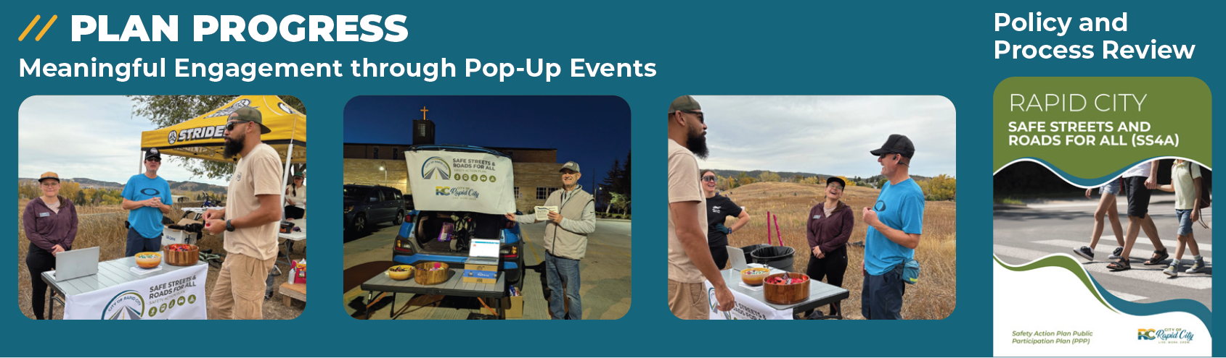
Study Progress

Slide 9
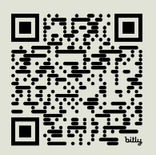
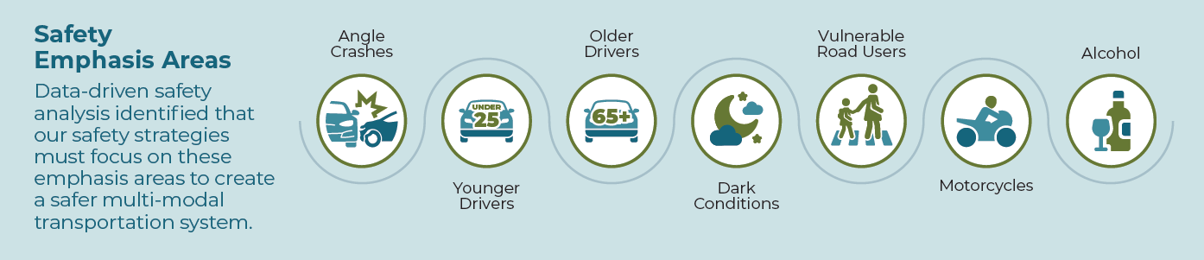
Prevalent Issues
Do you think these issues are present in Rapid City?
What issues not listed should be addressed?

Slide 10
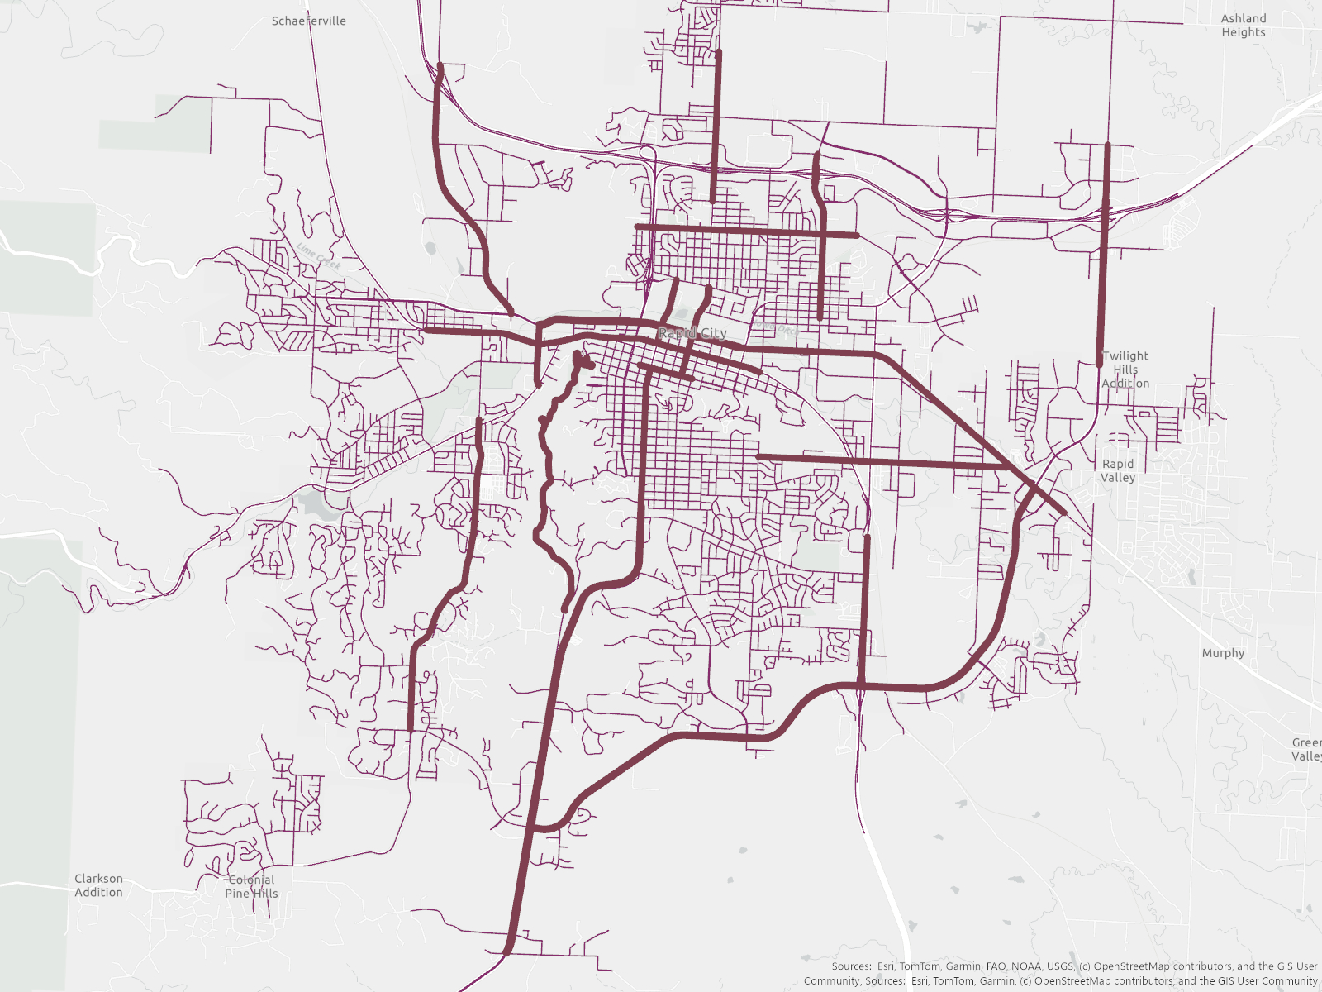
Safety Analysis
70% of fatal or serious injury crashes (KA crashes) occur 11% of Rapid City’s road network
The safety action plan will target this smaller area to focus on eliminating fatalities and serious injuries

Slide 11
High Priority Network Discussion

Slide 12
Projects and Strategies

Slide 13



What are your thoughts on access management?
Preferred |  |  |  | Not Preferred
What are your thoughts on lane reduction?
Preferred |  |  |  | Not Preferred
Notes:
Document for Questions: DRAFT RCAMPO 2050 MTP Public Open House 2 Survey Questions.docx

Slide 14
What are your thoughts on signalized intersections?
Preferred |  |  |  | Not Preferred
What are your thoughts on roundabouts?
Preferred |  |  |  | Not Preferred
Notes:
Document for Questions: DRAFT RCAMPO 2050 MTP Public Open House 2 Survey Questions.docx

Slide 15
What are your thoughts on prioritizing bicycle and pedestrian network expansion?
Preferred |  |  |  | Not Preferred
What are your thoughts on integrating complete streets into future roadway improvements?
Preferred |  |  |  | Not Preferred
Notes:
Document for Questions: DRAFT RCAMPO 2050 MTP Public Open House 2 Survey Questions.docxWhat are your thoughts on signalized intersections?

Slide 16
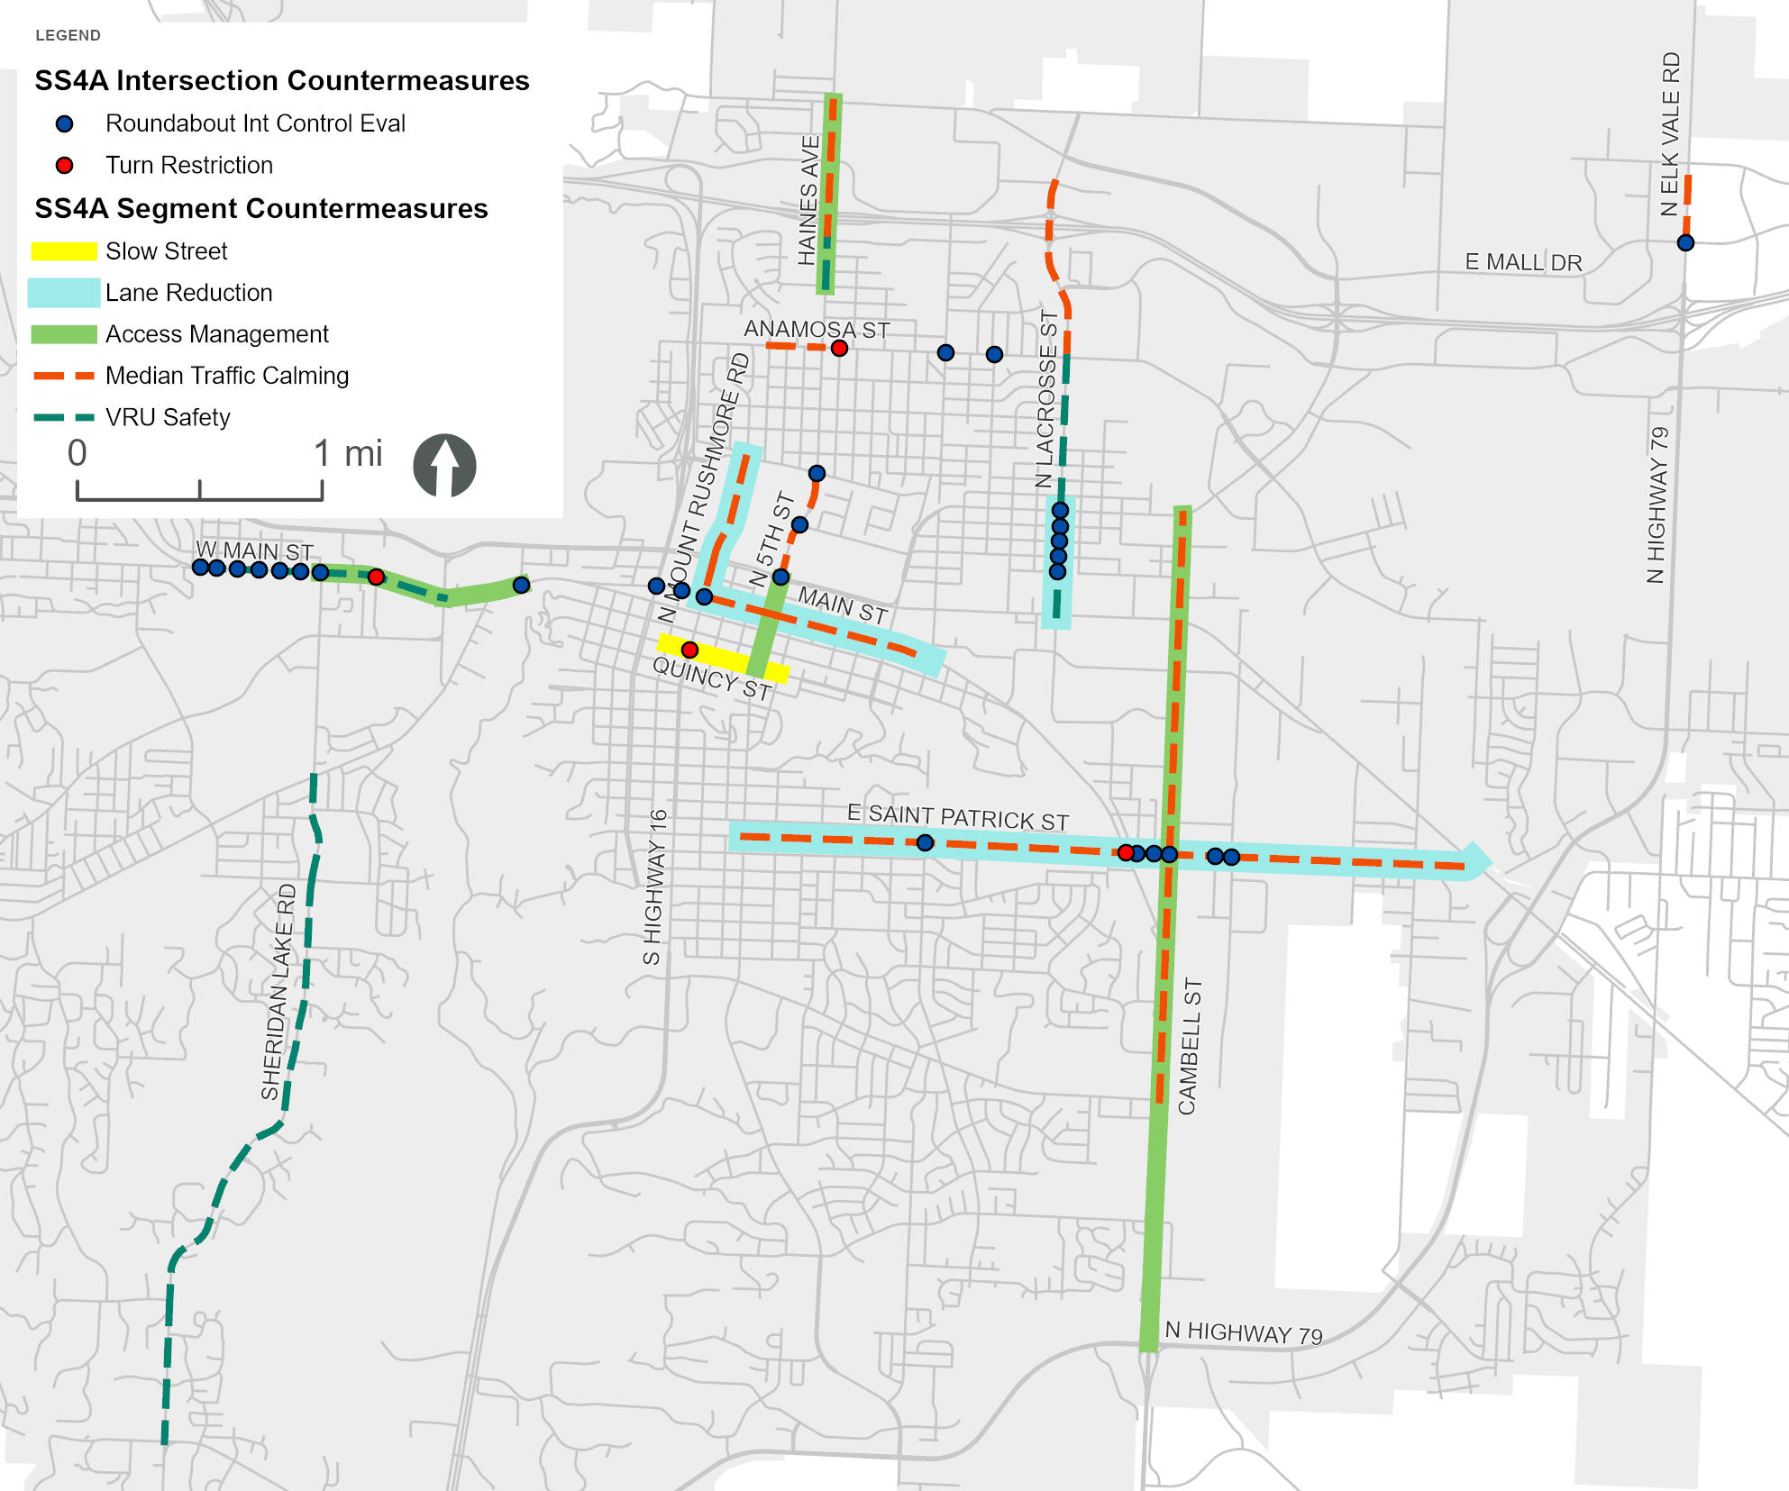
Projects and Strategies
Vote on the HDR provided ideas for projects
Provide ideas for improvement projects on the map
Notes:
Vote on the HDR provided ideas for projects
Provide ideas for improvement projects on the map

Slide 17
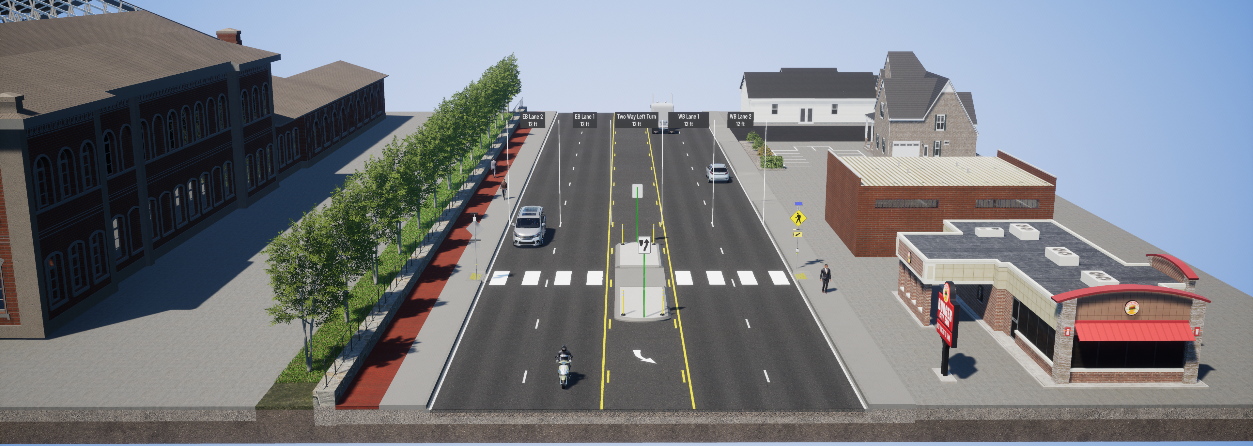
Visualizing Right-Sized Streets

Slide 18
Thank You

