Slide 1
Rapid City Young Driver Focus Group
July 15, 2025

Slide 2
Meeting Objectives
Rapid City SS4A plan overview
Discuss key safety issues in Rapid City that pertain to young drivers

Slide 3

Introductions
Name
Your travel experience in Rapid City
  Car
  Foot
  Bike
  Etc.
Notes:
Goal: Meet the folks in the room and get a feel for how safe/comfortable they feel driving in general. Note any mentions of particular corridors/opportunities, etc.

Slide 4
Project Background

Slide 5
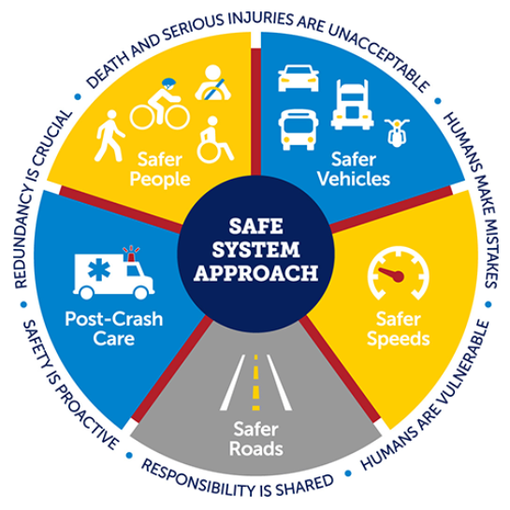
Safe System Approach
Eliminate traffic deaths and serious injuries
Improve overall safety of the transportation network for all users
Implement the Safe System Approach (SSA)
Notes:
The Safe Streets and Roads for All (SS4A) program is dedicated to implementing strategies that eliminate traffic deaths and serious injuries and improve the overall safety of the transportation network for all users.
Reaching zero deaths requires the implementation of a Safe System Approach (SSA). The SSA is comprised of five core elements and six principles.

Slide 6
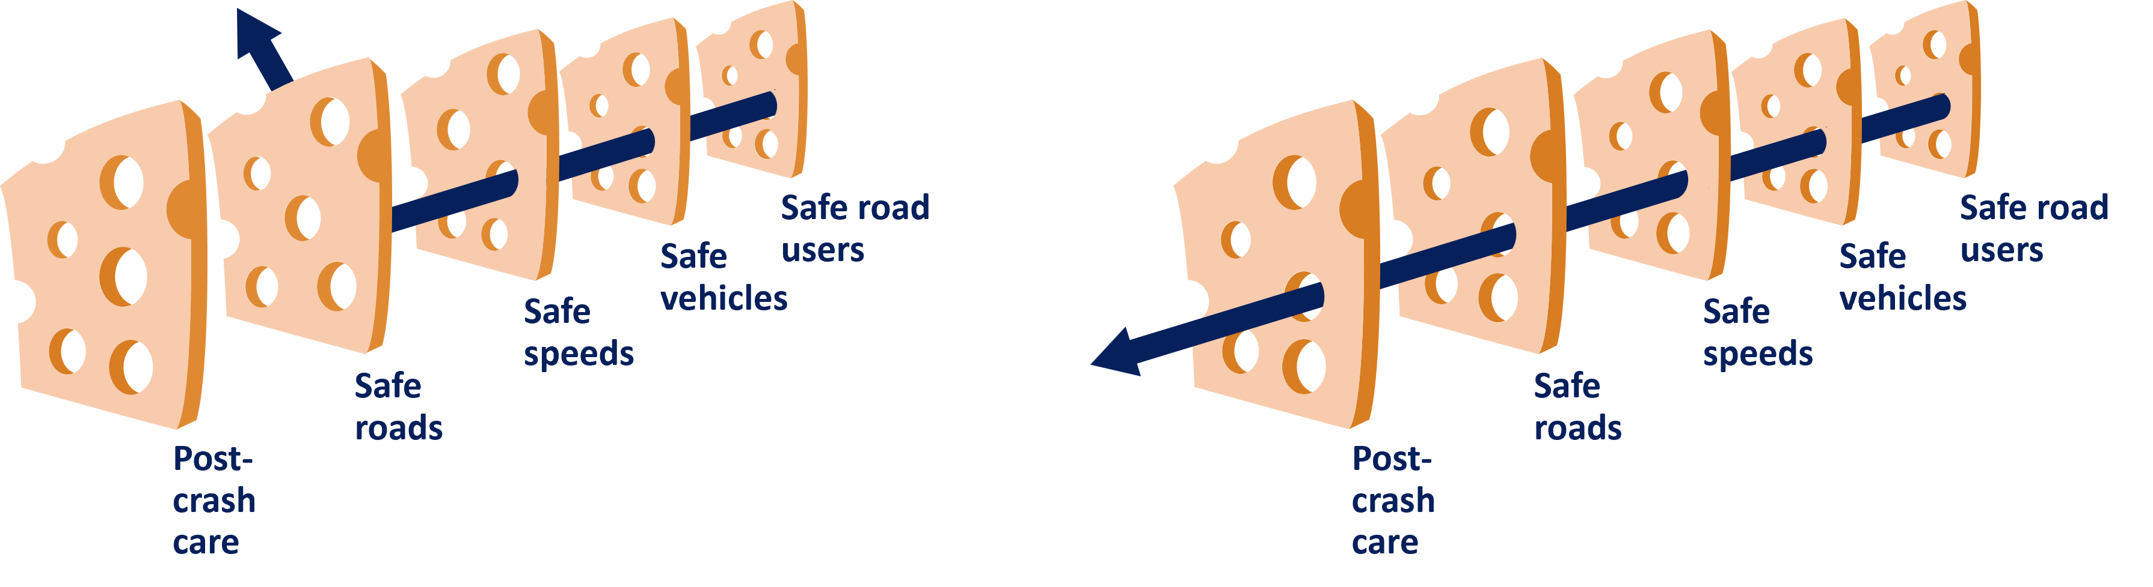
Safe System Approach
Focuses on both human mistakes and human vulnerability
Designing systems with layers of protection
Notes:
The Safe System Approach is a shift from conventional road safety thinking because it focuses on both human mistakes and human vulnerability by designing systems with layers of protection.
If one countermeasure fails, another will help prevent a crash or lessen the likelihood of serious injury or death.

Slide 7
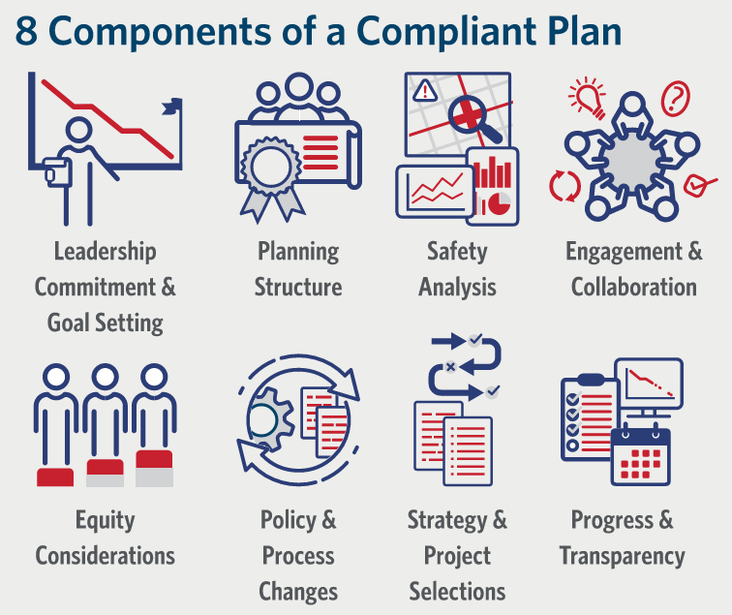
Components of a Project Plan
A holistic, well-defined strategy
Prevent roadway fatalities and serious injuries
Notes:
According to the USDOT, the goal of an Action Plan is to develop a holistic, well-defined strategy to prevent roadway fatalities and serious injuries.
A successful Action Plan includes the following eight key components.

Slide 8
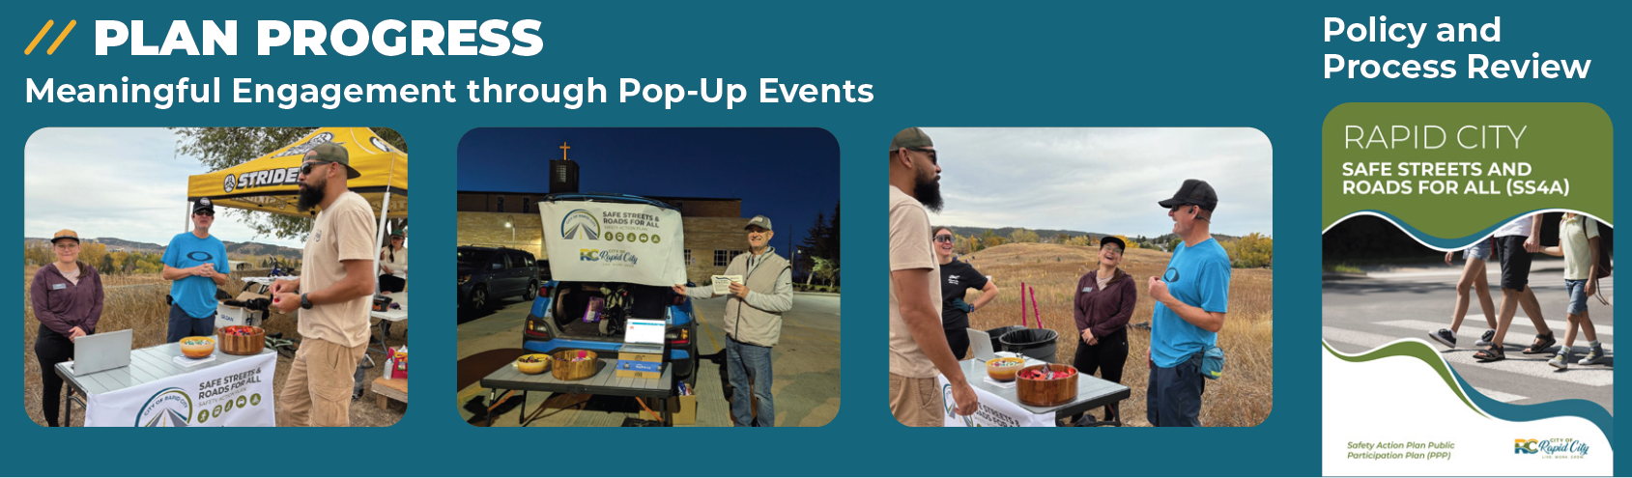
Study Progress

Slide 9
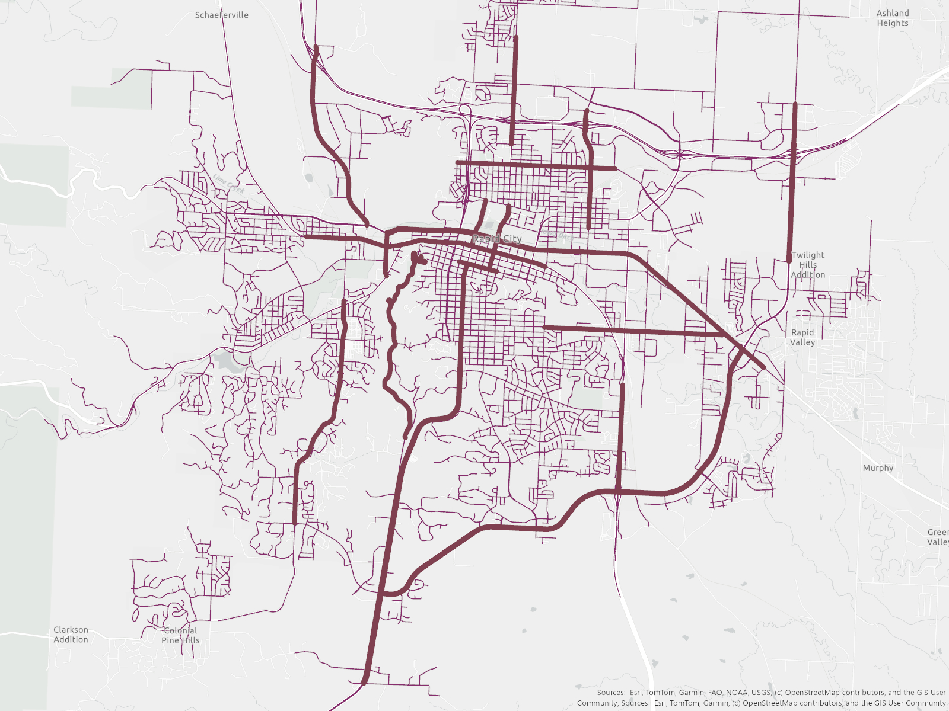
Study Purpose
70% of fatal or serious injury crashes (KA crashes) occur on 11% of Rapid City’s road network
The safety action plan will target this smaller area to focus on eliminating fatalities and serious injuries

Slide 10
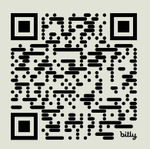
Discussion

Slide 11
General Feeling of Safety
How safe do you feel traveling in Rapid City?
1
2
3
4
5
Very Unsafe
Very Safe
Why?
Notes:
1 – always feel unsafe
2 – mostly feel unsafe
3 – sometimes feel safe, sometimes feel unsafe
4 – mostly feel safe
5 – always feel safe
Note that this can be by car, bike, foot, etc.

Slide 12
Areas of Concern
Do you agree with these highlighted areas?
Are there areas missing?

Slide 13
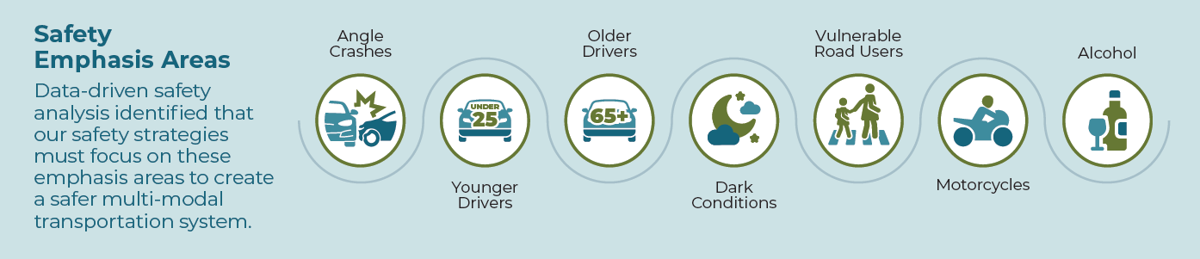
Prevalent Issues
Do you think these issues are present in Rapid City?
What issues not listed should be addressed?

Slide 14
Young Drivers Discussion

Slide 15
Younger Fatal/Serious Injury (KA) Crashes
Under 20: 17% of KA crashes
  7.7% of South Dakota licensed drivers
Under 25: 36% of KA crashes
  15% of South Dakota licensed drivers
Notes:
Table DL-22 - Highway Statistics 2023 - Policy | Federal Highway Administration – Source for number of licensed drivers 2023

Slide 16
Safety Concerns for Young Drivers
Common Young Driver Safety Concerns
Risk-taking tendencies
Nighttime driving
Driving under the influence
Passenger interactions
Seatbelt use
Cell phone use
Which of these safety concerns do you agree/disagree with?
Are there safety concerns not represented that you feel are prevalent to young drivers?
Notes:
Gathered info from NHSTA for baseline information

Slide 17
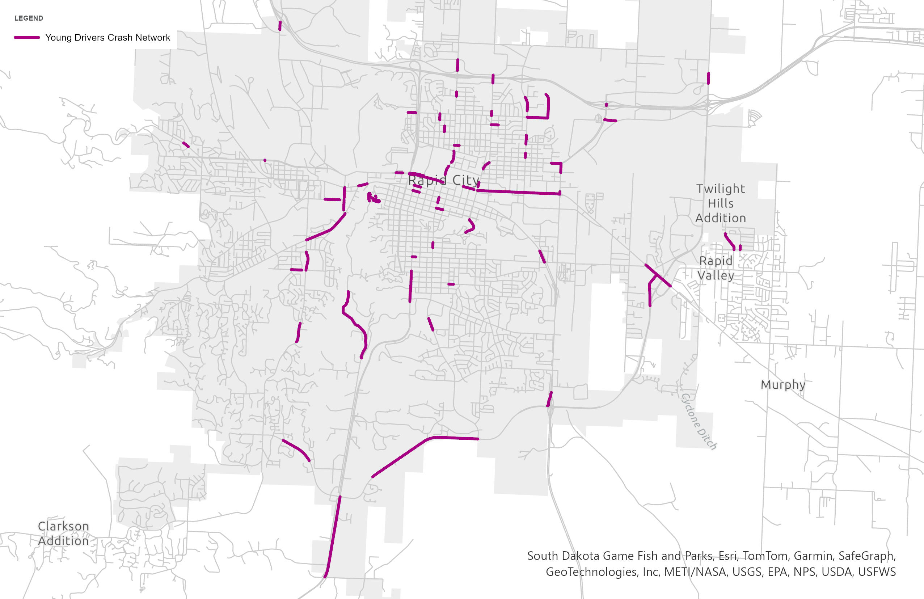
Difficult Areas and Features for New Drivers
What areas in Rapid City are difficult to navigate as a young driver?
  What makes those areas difficult?
Are there particular features that are challenging to navigate?

Slide 18

Driver’s Education Effectiveness
NHTSA generates a publication: “Countermeasures that Work”
Teens who took an additional driver’s education program had a 21% reduction in self-reported risky driving
Notes:
Electronic feedback in conjunction with in-person feedback reduced unsafe driving by 85%

Slide 19
Young Driver Strategies
Stronger Training & Licensing Requirements
Publicize & Enforce Laws
Assist Parents
Focus on Schools, Nighttime, Other activities
Street / Roadway Design Enhancements
Notes:
Implement or Improve Graduated Driver Licensing Systems Graduated driver licensing (GDL) systems provide the foundation for protecting young drivers, their passengers, and other road users. Most states have implemented GDL systems, but simply having a GDL system in place is not sufficient. It is important for GDL systems to include the most beneficial risk-reducing restrictions, including the following: • Enact a full GDL system. GDL is designed to provide beginning drivers with substantial driving practice under the safest possible conditions, exposing them to more risky situations (e.g., nighttime driving) only as experience is gained over time. • Require at least 6 months of supervised driving for beginners, starting at age 16. A substantial amount of practice is needed—at least 6 months—before a novice driver begins to develop the savvy required to be a proficient and safe driver. Driving with an adult supervisor enables novice drivers to gain needed “real world” driving experience in a reasonably safe fashion. • Implement a nighttime driving restriction that begins at 9 p.m. A disproportionately high number of young driver fatal crashes occur between the hours of 9 p.m. and 6 a.m. Beginning drivers should not be exposed to the most risky driving conditions. • Implement a passenger restriction allowing no young passengers. Carrying teen passengers greatly increases the risk of a serious crash for young drivers. Passenger restrictions for the first several months of unsupervised driving eliminate the distractions that teen passengers inevitably create. • Prohibit cell phone use by drivers with a GDL license. Recent research suggests that using a cell phone is associated with a fourfold increase in the likelihood of a serious crash among drivers of all ages. Reducing this risk for inexperienced drivers is an appropriate goal for a GDL system. Publicize, Enforce, and Adjudicate Laws Pertaining to Young Drivers Some laws pertain specifically to young drivers. Other laws that govern all drivers are particularly important for young drivers. Enhanced publicity, enforcement, and adjudication of these laws, including the following measures, will benefit young drivers: • Publicize and enforce GDL restrictions. To the extent that teens do not comply with protective restrictions under GDL systems, the safety benefits of GDL will be reduced. • Publicize and enforce laws pertaining to underage drinking and driving. Both minimum drinking age laws and “zero tolerance” laws have proven effective in reducing alcohol-related crashes and fatalities involving young drivers. SECTION I—SUMMARY I-2 A Guide for Reducing Collisions Involving Young Drivers Copyright National Academy of Sciences. All rights reserved. SECTION I—SUMMARY • Publicize and enforce safety belt laws. Safety belt use is lower among young drivers than among adult drivers. Well-publicized enforcement programs and primary safety belt laws have increased belt usage for all drivers, including teen drivers. Assist Parents in Managing Their Teens’ Driving Parents are inescapably involved in the licensing process of their children, even though they may not recognize the extent of their potential influence. Efforts to assist parents in this role, including the following, can benefit teen drivers: • Facilitate parental supervision of learners. More effective supervision of teen drivers holds substantial promise for further reducing young driver crashes. Simply distributing educational/advisory materials to parents is insufficient. Persuasive techniques that encourage parents to make use of materials and guidance are needed. • Facilitate parental management of intermediate drivers. Teen drivers experience a dramatic increase in crashes when they first begin driving alone. Parent-teen driving agreements and new technologies for monitoring teen drivers have the potential to reduce young driver crashes during this high-risk period. • Encourage selection of safer vehicles for young drivers. Teens often drive vehicles that are less likely to have important safety features. A program that encourages the greatest possible use of safer vehicles by young drivers holds substantial promise for reducing deaths and injuries among teen drivers and their passengers. Improve Young Driver Training Although there is no evidence that formal driver education classes are effective in reducing subsequent crash rates among novice drivers, there are a number of promising improvements that can be made in the training of young drivers administered by states: • Improve content and delivery of driver education/training. The model followed by current driver education programs in the United States was developed in the late 1940s. There is widespread belief that both what is taught and how it is taught can be improved significantly, with the promise that young driver crashes can be reduced as the result. Doing so will require a substantially more ambitious effort than simply adding content to the current curriculum. Employ School-Based Strategies Nearly all beginning drivers are in high school. This affords an opportunity to adopt strategies to reduce young driver crashes by implementing policies that take advantage of this natural grouping in both space and time to alter that environment: • Eliminate early high school start times. Recent developments in understanding human sleep needs indicate that teenagers need to be asleep in the early morning hours. As a result, school systems in the United States have begun to move school start times back to 8:30 or later. This promises to reduce young driver crashes. • Review transportation plans for new/expanded high school sites. When new schools are built, transportation plans should take into account that there will be a hig

Slide 20
Driver’s Education
How prepared do you feel from driver’s education?
What was the most important part of driver’s education?
What should have been better covered?

Slide 21
Open Discussion
Any questions?
Any areas we missed?

Slide 22
Projects and Strategies

Slide 23
Map Markup
Mark streets on the map that you think are high risk

Slide 24
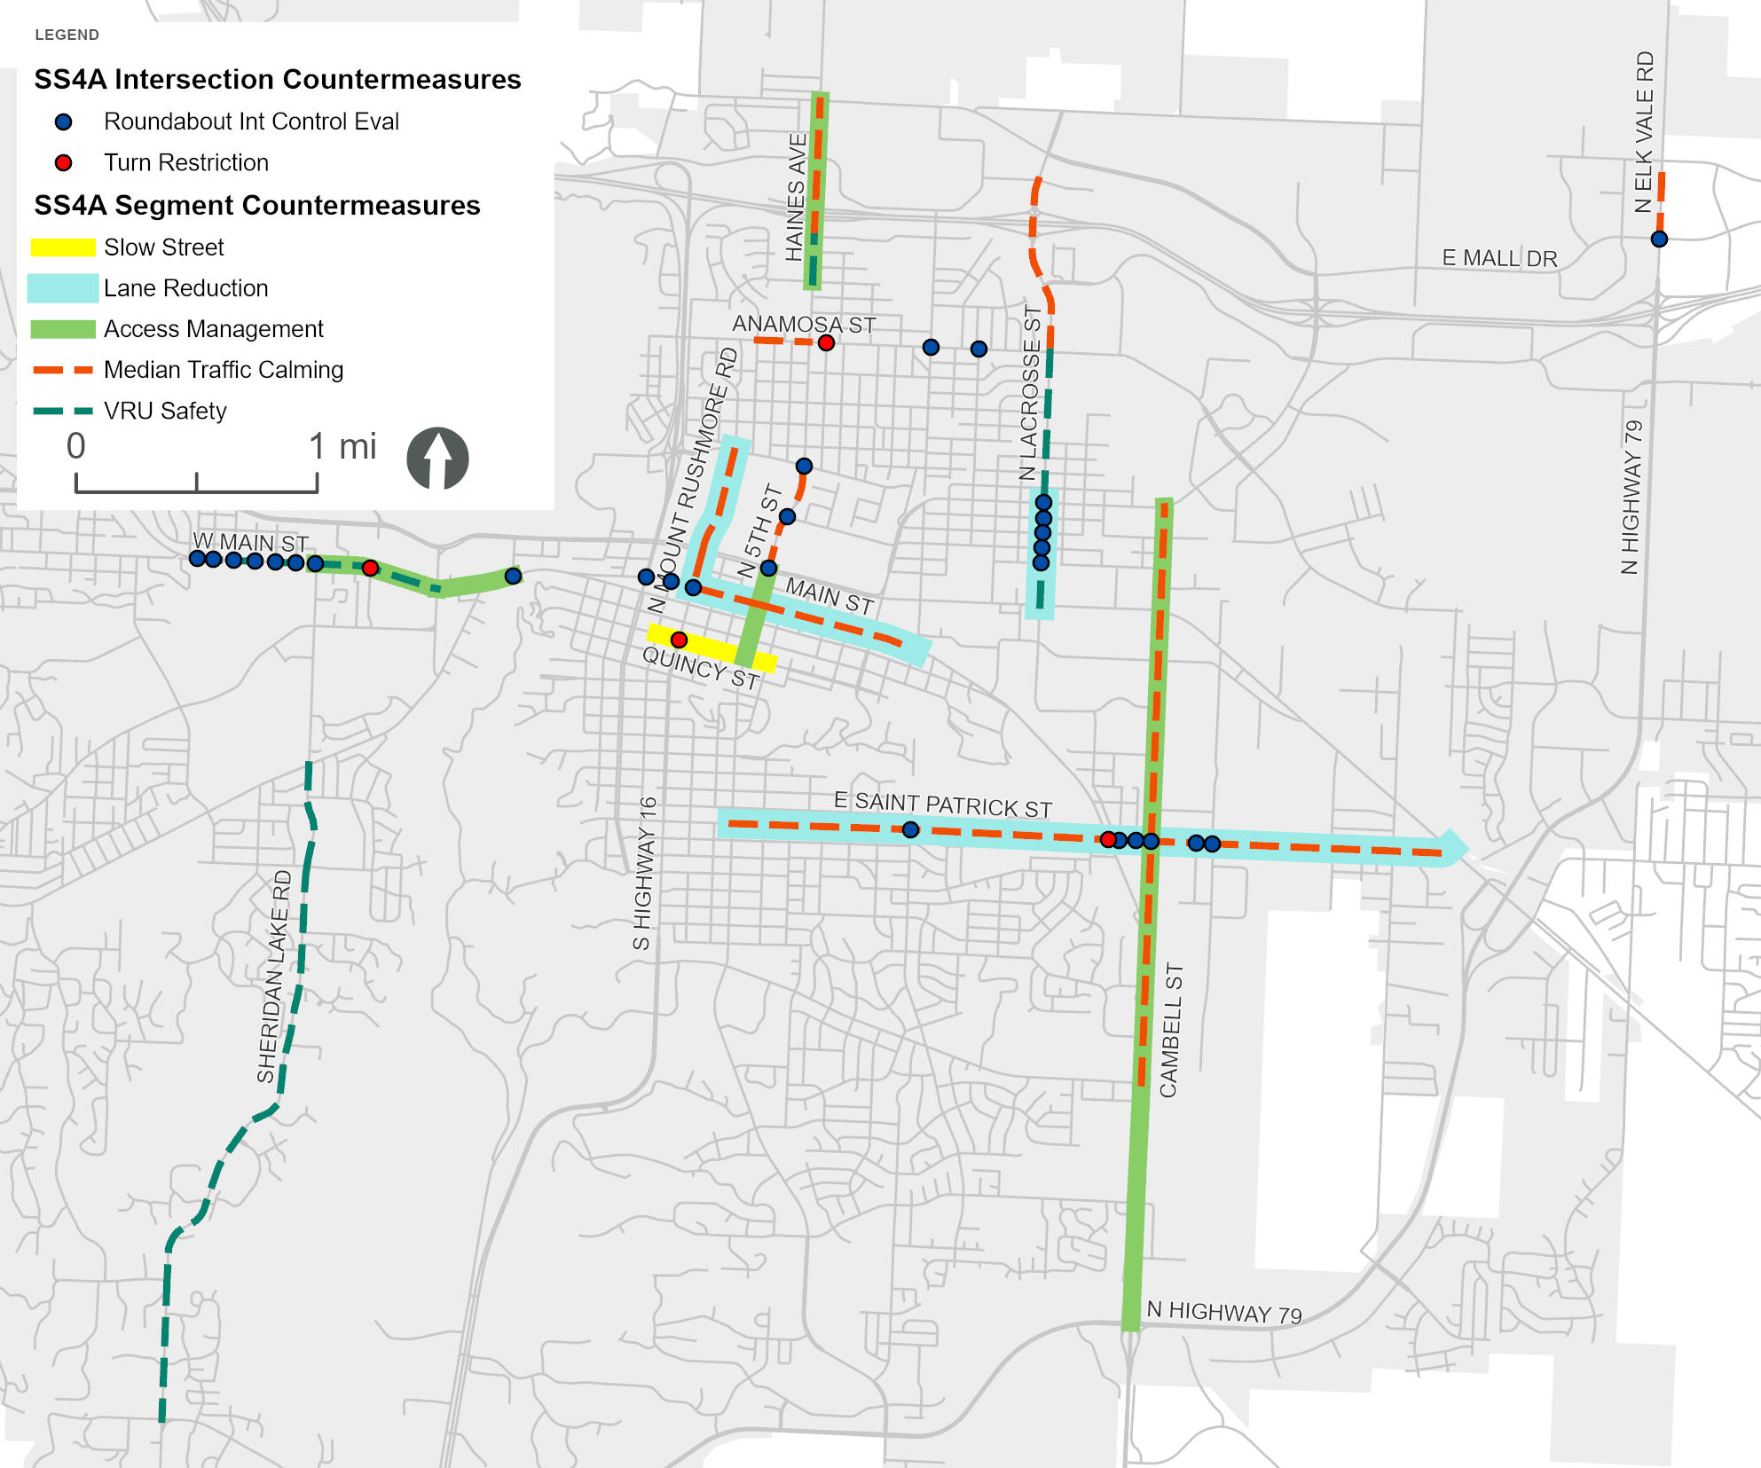
Projects and Strategies
Vote on the HDR provided ideas for countermeasures
Provide ideas for improvement projects on the map

Slide 25
Thank You

